Slide 1





ASI
Accounting Services
CLUB BANKING

Slide 2


HOW TO SET UP YOUR CLUB ACCOUNT?
Your club/organization is REGISTERED & in good standing with Student Organizations and Leadership (SO&L) & CSUS
You attended NUTS & BOLTS
You are READY to fill out the CLUB ACCOUNTING FORM (CAF)

Slide 3


COMPLETING THE CLUB ACCOUNTING FORM
CAF can be submitted through https://sa.sign-workflow.csus.edu
The treasurer or president will need to enter email information of authorized signers and faculty/staff advisor; this will start a workflow that will need to be FULLY completed before club banking can happen.
The form link will be emailed to each listed person to complete the form via Adobe Acrobat Sign
Once all parties have signed and the form is approved by ASI Accounting Services, EVERYONE will be notified via email with a copy of the agreement
$800 DOC Funds will be automatically deposited in club account once CAF is complete, not to exceed $2,000 if unspent.

Slide 4
CLUB ACCOUNTING FORM
A new CAF must be submitted by the club and validated by ASI Accounting Services every academic year.
A new CAF needs to be submitted if there are any changes to authorized signers or faculty advisor during the year
A valid CAF will allow only authorized signers to request a club balance, club reports, and authorize (sign) check requests.
Faculty Advisors can only request club balances (not withdrawals).
Club Balances and Reports can be requested in-person at ASI Accounting Services in the University Union (3rd Floor, Room 3230) or via email to asiaccounting@csus.edu
Club account number will be needed for deposits/withdrawals. Account # can be found on completed CAF.

Slide 5

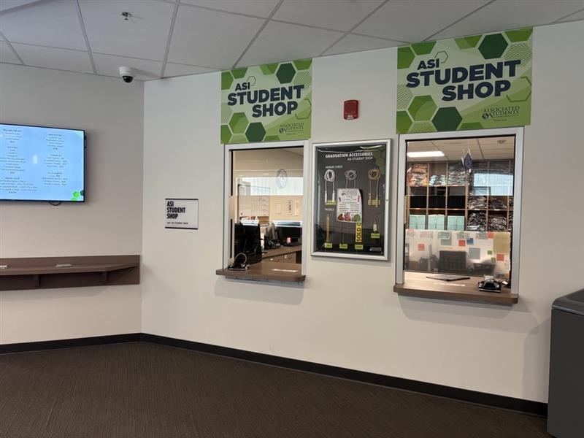
TIME TO MAKE A DEPOSIT?
VISIT THE ASI STUDENT SHOP!
Located: University Union, 3rd Floor, Room 3231

Slide 6


MAKING DEPOSITS
  Any person can deposit funds into the account, all they need is the club or organization name.
  Only cash and checks are accepted for deposits in-person. Online deposits are not available.
  Fill out a Club Deposit Sheet.
    Tips for making your transaction easier and faster, please visit: www.asi.csus.edu/post/club-deposits
  Deposits can be made during our normal business hours
  (see ASI Student Shop for current hours)
  Union/WELL Invoices can also be paid at the ASI Student Shop

Slide 7

WITHDRAWALS
  The clubs’ funds are “rolled-up” into ASI’s checking account, so all club withdrawals are done through a check request process. Clubs do not have separate checking accounts.
  All check requests are submitted online through JotForm https://form.jotform.com/241087037358156
  Requests submitted by 5 p.m. on Wednesdays are processed and mailed by the following Thursday. (Check pick-ups are done by request only)
    Forms with no issues are completed in this time frame
    Forms with issues that require contacting the club will extend processing time
    If picking up a check from ASI Student Shop, photo ID is required.
  Check our website for any special check run dates that fall within holidays or campus closures.

Slide 8


CLUB BANKING HELP?
Ask us! Email questions to asiaccounting@csus.edu. We respond within one business day. Or call us Monday through Friday from 8 a.m. to 5 p.m. at (916) 278-2231.
Phone: (916) 278-2231
Email: asiaccounting@csus.edu
Website: www.asi.csus.edu/accounting-services

