Slide 1

ACCOUNTING SERVICES
CLUB BANKING
2026-2027
Notes:
Welcome new and returning leaders!
We are Julie Ton and Elvia Felix with Accounting Services of Associated Students, Inc. (or ASI for short) here to talk to you about how your student organization or club can bank with us.

Slide 2
OVERVIEW:
What is Associated Students, Inc. (ASI)?
What does ASI Accounting Services have to do with student organizations and clubs?
How to bank with ASI and access your club account
How to Access and Complete the Club Accounting Form (CAF)
ASI Grants
ASI Student Shop
Examples of Check Requests
How to Contact Us
Questions
Notes:
During this session, we will go over a few topics:
-what is ASI?
-what do we have to do with your student orgs and clubs
-how you can bank with us and access the funds in your club account for payments and reimbursements
-how to access and complete the Club Accounting Form (CAF)
-we will share a few ASI Grants available to you
-ASI Student Shop services
-then we will do a quick walkthrough on how to submit three different types of check requests
-provide information on how you can contact us with any questions
-finally, we will open the floor to answer any questions you may have for us

Slide 3
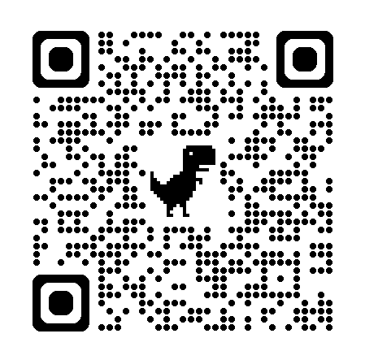
WHAT IS ASSOCIATED
STUDENTS, INC. (ASI)?
ASI is one of Sac State’s non-profit organizations.
ASI’s Programs & Services:
Sac State Aquatic Center (classes and equipment rentals)
Children’s Center
Food Pantry
Student Government (grants for orgs. and clubs are available)
KSSU Radio
Peak Adventures (team building programs, The Challenge
Center ropes course, and adventure trips)
Safe Rides
Student Shop (graduation regalia for students)
For more information on our programs and services, please visit:
https://asi.csus.edu
Notes:
Sac State has several non-profit auxiliary organizations to assist them, and ASI is one of them.
Our programs and services include the following (and in parenthesis are options where our programs can collaborate with your organization or club):
Sac State Aquatic Center, the public water recreation facility, which offers classes and equipment rentals
Children’s Center, which is our on-campus and accredited childcare program serving Sac State students, faculty, and staff
Food Pantry that provides food and basic necessities at no-cost to Sac State students with financial hardships and low food security
Student Government, which offers several grants for organizations and clubs
KSSU Radio, the only campus student-run radio station
Peak Adventures, our outdoor recreation and leadership program, where you can work with staff to put together team building programs, book the Challenge Center ropes course, and adventure trips
Safe Rides, with our mission to reduce DUI incidents and encourage safe transportation by offering reimbursements for rideshare services, taxies, and public transportation. They have also opened it up to a SMOG check, a vehicle safety inspection, and a real ID application.
Student Shop, which provides notary services and sells discounted movie tickets, stamps, envelopes, and where clubs often purchase graduation regalia for students
For more information on our programs and services, please visit: asi.csus.edu

Slide 4
WHAT DOES ASI ACCOUNTING SERVICES HAVE TO DO WITH STUDENT ORGANIZATIONS & CLUBS?
ASI has partnered with Student Organizations & Leadership (SO&L) to assist with the banking aspect for student organizations and clubs. Student organizations and clubs are expected to bank and maintain their club account with us.
Clubs can:
  deposit funds into their club account (e.g., membership fees/dues, sponsorships and awards, donations, fundraisers, and sales)
  request a club account report to see recent transactions and balances
  submit check requests for direct payment or reimbursements
  be eligible for an $800 Dollars for Organizations and Clubs (DOC) grant from ASI
Notes:
So what does we have to do with your Organization or Club?
Because ASI is an auxiliary organization, we are not directly related to Student Organizations & Leadership (SO&L), but we have partnered with them to assist with the banking aspect for student organizations and clubs. Your organization or club is expected to bank and maintain your club account with us.
Clubs can:
-deposit funds into your club account, such as membership fees, club dues, sponsorships and awards, donations from individuals or companies, revenue from fundraisers, and sales.
-Second, you can request a report of your club account to see recent transactions (deposits and withdrawals) and balances of your funds. With the club report, this will help your club plan whether you need to raise money to accomplish all the activities and events you plan to host for the upcoming year, as well as track completed check request payments and reimbursements
-Third, you can submit check requests, where our team will issue a check directly to a vendor for items or services rendered, or to reimburse someone for purchases already made using your club’s funds.
-Lastly, your club can be eligible for an $800 Dollars for Organizations and clubs (DOC) grant from ASI

Slide 5
HOW TO BANK WITH ASI & ACCESS YOUR CLUB ACCOUNT
Your organization/club must:
Be in good standing with Sacramento State
Register/renew their recognition with Student Organizations & Leadership (SO&L)
You can now complete the CLUB ACCOUNTING FORM (CAF)!
Notes:
To access your club account, you must complete a Club Accounting Form (CAF).
But before you can complete the CAF, you must first:
Be in good standing with Sacramento State
Register or renew your recognition with SO&L
-Please carefully read and complete the recognition process with SO&L. Any hold ups with this step will cause delays.
After your club has fully renewed your recognition with SO&L, you can complete the Club Accounting Form (CAF).

Slide 6
ACCESSING THE
CLUB ACCOUNTING FORM (CAF)
The link to the CAF can be accessed two ways:
1) ASI Accounting Services:
    https://asi.csus.edu/clubsdoc-check-request
      -Click on “Club Accounting Form”
2) SO&L’s Treasurer Resources:
    https://www.csus.edu/student-life/student-organizations/treasurer-resources.html
      -includes details on how to track the status/progress of your CAF
      -step-by-step walkthrough video
Notes:
The weblink to the CAF can be found in two areas:
First is the ASI Accounting Services’ website; you will click on “Club Accounting Form”
Second is SO&L’s Treasurer Resources website. This website has details on how you can track the status/progress of your CAF, and it also includes a step-by-step walkthrough video with tips and common errors that could lead to a denial

Slide 7
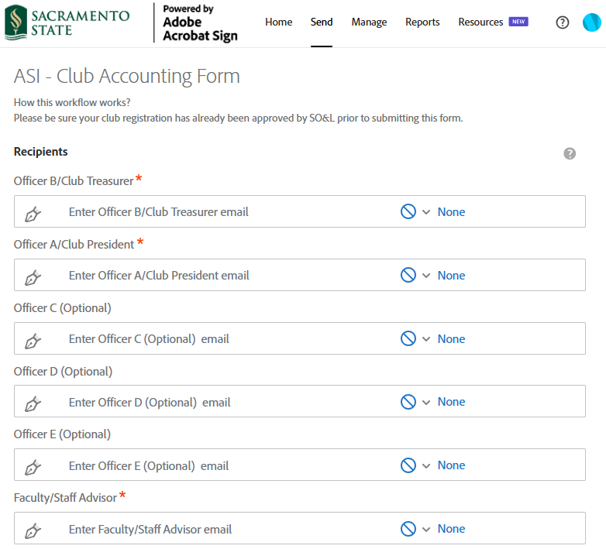
COMPLETING THE
CLUB ACCOUNTING FORM (CAF)
The treasurer or president will enter the CSUS email addresses of:
  -treasurer
  -president
  -optional: any additional club officers that will have authorization to transact club business; they must be on your approved club registration
  -faculty/staff advisor
Note: Ensure each email address is entered in the correct role (treasurer, president, faculty/staff advisor).
Notes:
Once you click the link to the CAF, you will be required to log into Adobe Acrobat Sign using your SacLink account details.
Next, you will see this page where the treasurer or president will enter the CSUS email addresses of:
-treasurer
-president
-any additional club officers that will have authorization to transact club business. This is optional and up to you and your officers to decide. Please keep in mind the officers must be on your approved club registration, otherwise your CAF will be denied by SO&L.
-faculty or staff advisor
Please ensure that each email address you listed is entered accurately and under the correct role. This is a common denial by SO&L.
For example, enter the president’s email address under “Officer A/Club President,” enter the treasurer’s email address under “Officer B/Club Treasurer,” so on and so forth.

Slide 8
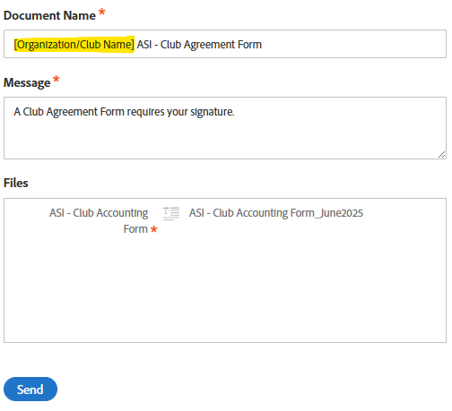
COMPLETING THE
CLUB ACCOUNTING FORM (CAF)
Add your organization/club name to the “Document Name” for visibility.
Personalize the “Message” so that the people receiving the form will understand what the form is for.
After the form is submitted, the form will route to each listed email address (will go to treasurer first) to review and sign the agreement via Adobe Acrobat Sign.
Notes:
In the next section, add your organization or club name to the “Document Name” for visibility.
If you want, you can personalize the “message” section so that the people receiving the form via email will understand what the form is for.
Finally, click “Send.”
After the form is submitted, the form will route to each listed email address (treasurer first) to review and sign the agreement via Adobe Acrobat Sign.

Slide 9
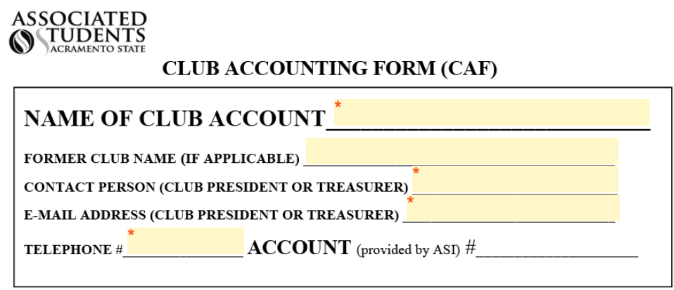
COMPLETING THE
CLUB ACCOUNTING FORM (CAF)
The form will go to the treasurer first to fill out the form.
The treasurer will enter:
the club’s official full name
  Note: acronyms are not accepted
if applicable, the club’s former name if the name was recently changed
their full name, email address, and telephone number
Notes:
The form will go to the treasurer first to complete the form.
They will enter:
-the club’s official full name. Please note that acronyms are not accepted, and it is one reason SO&L will deny the CAF.
-the club’s former name, if applicable
-their full name, email address, and telephone number

Slide 10
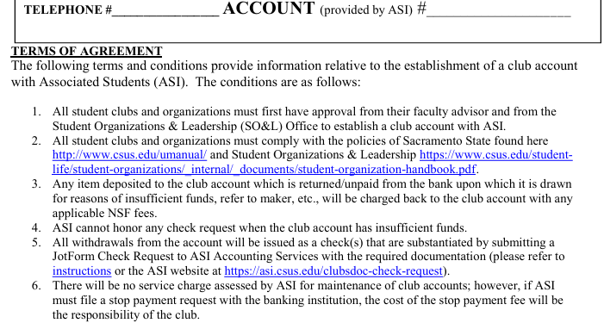
COMPLETING THE
CLUB ACCOUNTING FORM (CAF)
The treasurer will need to read the Terms of Agreement.
Notes:
Next, the treasurer will need to read the terms of agreement in its entirety, before moving onto the next page.

Slide 11
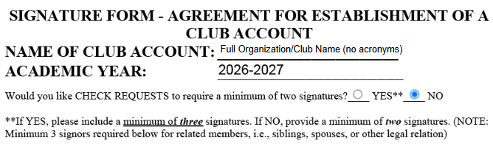
COMPLETING THE
CLUB ACCOUNTING FORM (CAF)
Next, the treasurer will select how many officers are required to authorize (sign) check requests and other financial documentation:
  if you require one club officer to sign financial documentation, select “No.”
  if you require a minimum of two club officers to sign financial documentation, select “Yes.”
Notes:
The treasurer will select how many officers are required to authorize (and sign) check requests and other financial documentation:
-if you require one club officer to authorize and sign financial documentation, select “No.”
-if you require a minimum of two club officers to authorize and sign financial documentation, select “Yes.”

Slide 12
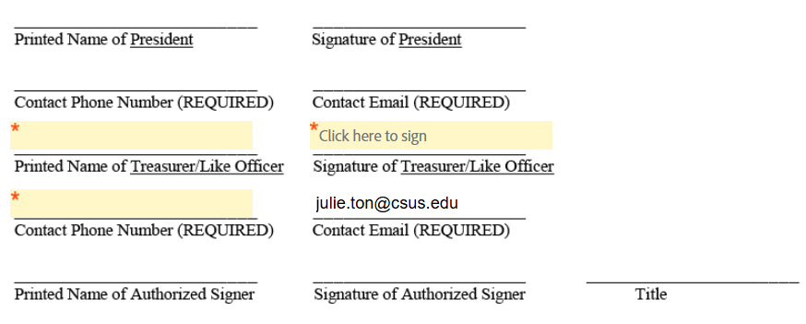
COMPLETING THE
CLUB ACCOUNTING FORM (CAF)
The treasurer will enter their full name, phone number, and add their signature.
Notes:
The treasurer will then enter their full name, phone number, and add their signature.

Slide 13
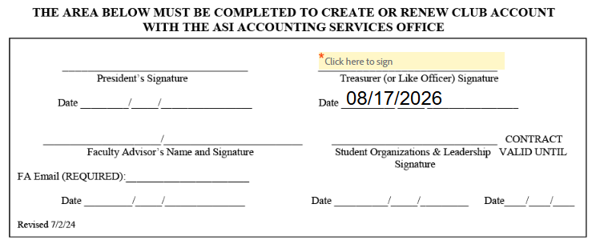
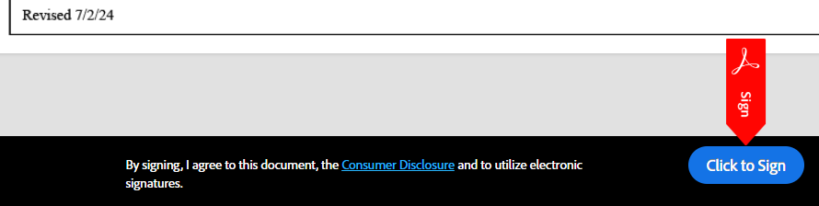
COMPLETING THE
CLUB ACCOUNTING FORM (CAF)
In the next section, Treasurer will add their signature again.
Treasurer will review the information entered on both pages for accuracy.
Once everything is accurate, click on “Click to Sign” at the bottom of the page.
The form will route to the club president to review and sign the agreement.
Notes:
The treasurer will add their signature again in the next section.
The form cannot be edited once it is submitted, so please review the information for accuracy.
Once everything is accurate, click on “Click to Sign” at the bottom of the page. The form will route to the club president next to review and sign the agreement.

Slide 14
COMPLETING THE
CLUB ACCOUNTING FORM (CAF)
After the club president and faculty/staff advisor sign the form, it will route to SO&L to review the form for accuracy before approval.
Once SO&L approves the CAF, ASI Accounting Services will finalize the form. At this point, the form will be active effective immediately and EVERYONE listed on the CAF will be notified via email with a copy of the agreement.
Notes:
After the club president and faculty/staff advisor sign the form, it will route to SO&L to review the form for accuracy before approval.
If SO&L denies the CAF, they will leave a reason for the denial. You will need to resubmit a new CAF with the correct information.
Once SO&L approves the CAF, ASI Accounting Services will finalize the form.
At this point, the form will be active effective immediately and EVERYONE listed on the CAF will be notified via email with a copy of the agreement.

Slide 15
MORE ON THE
CLUB ACCOUNTING FORM (CAF)
A new CAF must be submitted by the club and validated by ASI Accounting Services every academic year.
If there are any changes to authorized signers or faculty/staff advisor during the year, you will need to submit a new registration and have it approved by SO&L first, then submit a new CAF.
A valid CAF allows authorized signers to request a club balance report and authorize (sign) check requests.
  Faculty/Staff Advisors can only request club balances; they cannot authorize check requests.
  Club balance reports can be requested in-person at ASI Accounting Services or via email.
    Photo ID will need to be presented when requesting in-person
    The email listed on the CAF must be used when requesting via email
Your club account number is required for deposits and withdrawals. This can be found on the top-right of the approved CAF.
Notes:
A few more things to note about the CAF:
-A new CAF must be submitted by the club and validated by ASI Accounting Services every academic year
-if there are any changes to authorized signers or faculty/staff advisor during the year (for example, your president graduates after the fall semester), you will need to submit a new registration and have it approved by SO&L first, then submit a new CAF
-A valid CAF only allows authorized signers to request a club balance report and authorize (sign) check requests.
Faculty/Staff Advisors can only request club balances; they cannot authorize check requests.
Club balance reports can be requested in-person at ASI Accounting Services or via email
Please note: photo ID will need to be presented when requesting in-person
Your Sac State email address listed on the CAF must be used when requesting via email
-Your club account number is required for deposits and withdrawals. The account number can be found on top-right of the approved CAF.
Now, Elvia Felix will take over to explain the ASI Grants available to your organization or club.

Slide 16
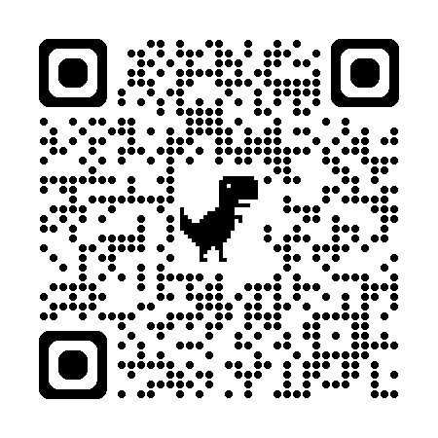
ASI GRANTS
  Available ASI Grants for your organization/club:
  Dollars for Organizations and Clubs (DOC)
  National Conference Transportation Funds
  National Sports Competition Transportation Funds
For details and to apply for ASI’s grants, please visit:
https://asi.csus.edu/asi-grants
Notes:
We will briefly go over a few available grants awarded by ASI!
In a previous slide, we mentioned that by banking with us, your club can be eligible for a $800 grant from ASI, which is the Dollars for Organization and Club (DOC).
We also offer two travel grants, the National Conference Transportation Funds and the National Sports Competition Transportation Funds, to help support travel expenditures for mileage, gas, car rental, taxi, rideshare (Lyft, Uber), and bus, train and air travel.

Slide 17
ASI GRANTS
  DOLLARS FOR ORGANIZATIONS AND CLUBS (DOC):
  Purpose of funding: to support Sac State students in their endeavors to increase the quality of campus life and learning. ASI DOC funding reimburses organizations and clubs for money spent on events, food, promotion, conferences, and much more.
  What to know:
    in 2025-2026, ASI awarded the DOC fund grant to 222 organizations/clubs
    The grant is on a first-come, first-served basis through May 31st
    please review the DOC Funding Guidelines on restrictions, such as:
      funded events and activities must be open to ALL Sacramento State students
      Items/events utilizing DOC funds cannot be resold or charged admission fees
      Cannot be used for honorariums, speaker fees, gifts, gift cards, random drawings, donations, etc.
Notes:
The purpose for the Dollars for Organization and Club (DOC for short) grant is to support Sac State students in their endeavors to increase the quality of campus life and learning. ASI DOC funding reimburses organizations and clubs for money spent on events, food, promotion, conferences, and much more.
-in the last academic year, ASI awarded the DOC fund grant to 222 organizations and clubs
-the grant is on a first-come, first-served basis through May 31st
⁻please review the DOC Funding Guidelines on restrictions, such as:
funded events and activities must be open to ALL Sacramento State students
Items/events utilizing DOC funds cannot be resold or charged admission fees
Cannot be used for honorariums, speaker fees, gifts, gift cards, random drawings, donations, etc.

Slide 18
ASI GRANTS
  What to know about DOC (continued):
    maximum accumulative allocation of $2,000 per club account within an academic year, with additional funding contingent upon the expenditure of at least $800 in previously awarded DOC monies
      upon approval of your CAF, we will review your club’s DOC account:
        If your DOC balance is $1,200 and less, the $800 grant will be transferred.
        If your DOC balance is $1,200.01 and more, we will not transfer the $800 grant until you use enough of your funds and reach $1,200 and less.
  We highly encourage you to use your DOC funds (when eligible) before using your club funds! If insufficient DOC funds are available, then club funds can be used to cover the remaining amount.
Notes:
-maximum accumulative allocation of $2,000 per club account within an academic year, with additional funding contingent upon the expenditure of at least $800 in previously awarded DOC monies
-Essentially, upon approval of your CAF, we will review your club’s DOC account:
-If your DOC balance is $1,200 and less, the $800 grant will be transferred.
-If your DOC balance is $1,200.01 and more, we will not transfer the $800 grant until you use enough of your existing funds and reach $1,200 and less. Our team will review your DOC balance again at the end of every month for eligibility.
-We highly encourage you to use your DOC funds (when eligible) before using your club funds! If insufficient DOC funds are available, then club funds can be used to cover the remaining amount.

Slide 19
ASI GRANTS
  NATIONAL CONFERENCE TRANSPORTATION FUNDS
  Purpose of funding: to support clubs and organizations in managing travel expenses for attending National Conferences.
    What to Know:
      First-come, first-served basis
      Clubs and organizations must be attending a National Conference to apply
      Each applicant may receive a maximum of up to *$1,000 per club/org, depending on location
      Only direct travel expenditures related to transportation will be funded
      Application and receipts must be submitted no later than four weeks after the event
      Club/org receiving money from this fund is not eligible to receive money from any other ASI Travel Fund for the same event
      If your club/org is awarded the grant, the award will be transferred to your club account soon after the approval; you will need to submit a check request for the reimbursement
Notes:
ASI offers two travel-related grants, one of which is the National Conference Transportation Fund.
The purpose is to support clubs and orgs in managing travel expenses for attending National Conferences.
Some things to know:
First-come, first-served basis
Clubs and organizations must be attending a National Conference to apply
Each applicant may receive a maximum of up to $1,000 per club/org, depending on the location of the conference
Only direct travel expenditures related to transportation will be funded
Application and receipts must be submitted no later than four weeks after the event
Club/org receiving money from this fund is not eligible to receive money from any other ASI Travel Fund for the same event
If your club/org is awarded the grant, the award will be transferred to your club account soon after the approval; you will need to submit a check request for the reimbursement

Slide 20
ASI GRANTS
  NATIONAL SPORTS COMPETITION TRANSPORTATION FUNDS
  Purpose of funding: to support clubs and organizations in managing travel expenses for those qualifying for National Sports Competitions.
    What to Know:
      First-come, first-served basis
      Clubs and organizations must qualify for a National Sports Competition before applying for the grant or the SO&L advisor can attest that the competition is the highest level within the sport
      Each applicant may receive a maximum of up to *$1,000 per club/org, depending on location
      Only direct travel expenditures related to transportation will be funded
      Application and receipts must be submitted no later than four weeks after the event
      If your club/org is awarded the grant, the award will be transferred to your club account soon after the approval; you will need to submit a check request for the reimbursement
Notes:
The other travel-related grant is the National Sports Competition Transportation Fund.
The purpose is to support clubs and orgs in managing travel expenses for those qualifying for a National Sports Competition.
Some things to know:
First-come, first-served basis
Clubs and organizations must qualify for a National Sports Competition before applying for the grant or the SO&L advisor can attest that the competition is the highest level within the sport.
Each applicant may receive a maximum of up to $1,000 per club/org, depending on the location of the competition
Only direct travel expenditures related to transportation will be funded
Application and receipts must be submitted no later than four weeks after the event
If your club/org is awarded the grant, the award will be transferred to your club account soon after the approval; you will need to submit a check request for the reimbursement

Slide 21
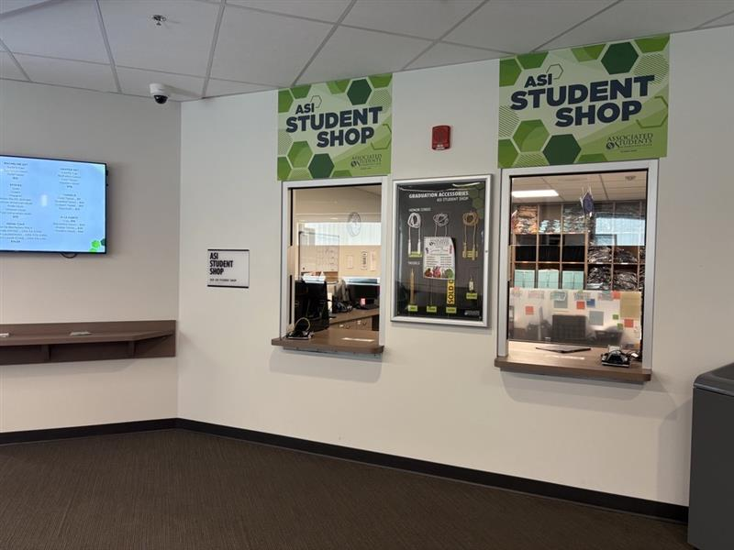
ASI STUDENT SHOP
Visit the Student Shop to:
make deposits
pay for Union/WELL/Games Room invoices
purchase regalia for graduating club members (ask about options to customize stoles)
request a cash box for your event in advance
  Note: cash boxes will not be given out the same day, no exceptions
Location: University Union, 3rd Floor, Room 3231
Notes:
Now we will move onto deposits and how to “withdraw” from your club account.
Visit the Student Shop on the 3rd floor of the University Union to:
make deposits
pay for Union/WELL/Games Room invoices
purchase regalia for graduating club members (ask about options to customize stoles)
request a cash box for your event in advance
Note: cash boxes will not be given out the same day, no exceptions

Slide 22
MAKING DEPOSITS
  Online deposits are not available.
  Only cash and checks are accepted for deposits.
  Any person can deposit funds into the account. They need the club/organization name, their Sac State OneCard (for students), and to fill out a Club Deposit Sheet.
    For tips to make your transaction easier and faster, please visit: www.asi.csus.edu/post/club-deposits
  Union & The WELL Invoices can be paid at the ASI Student Shop
    Can be paid with a debit/credit card or check
  Deposits can be made during normal business hours
  (see ASI Student Shop for current hours)
Notes:
Online deposits are not available at the moment.
Only cash and checks are accepted for deposits.
Any person can deposit funds into the account. They need the club/organization name, their Sac State OneCard, and to fill out a Club Deposit Sheet.
For tips to make your transaction easier and faster, please visit the following website: www.asi.csus.edu/post/club-deposits
Union & WELL Invoices can also be paid at the ASI Student Shop. These invoices can be facility room rentals at Union or The WELL, Games Room rental, Fitness instructors at the WELL, etc. These can be paid with a debit card, credit card, or a check
Deposits can be made during normal business hours

Slide 23
WITHDRAWALS
  All club funds are “rolled-up” into ASI’s checking account, so clubs do not have separate checking accounts.
  All club withdrawals are done through a check request process.
  All check requests are submitted online through JotForm (link available on our website): https://ascsusacramento.jotform.com/241087037358156
  Requests submitted by 5 p.m. on Wednesdays are processed and mailed by the following Thursday. Check pick-ups are done by request only.
      Submissions with no issues are completed in this time frame.
      Submissions with missing information or supporting docs will extend processing time.
      During periods of high volume of check request submissions, our processing time can extend to several weeks.
      If picking up a check from the ASI Student Shop, photo ID is required.
  Check our website for any special check run dates that fall within holidays or campus closures.
Notes:
-All clubs’ funds are “rolled-up” into ASI’s checking account, so clubs do not have separate checking accounts.
-All club withdrawals are done through a check request process.
-All check requests are submitted online through JotForm (link available on our website): https://ascsusacramento.jotform.com/241087037358156
-Requests submitted by 5 p.m. on Wednesdays are processed and mailed by the following Thursday. Check pick-ups are done by request only.
Submissions with no issues are completed in this time frame.
Submissions with missing information or supporting docs will extend processing time.
During periods of high volume of check request submissions, typically towards the end of the semester, our processing time can extend to several weeks.
We have a small student staff that processes these. We really appreciate your patience during this time as we process them in the order they were received.
If picking up a check from the ASI Student Shop, photo ID is required.
-Check our website for any special check run dates that fall within holidays or campus closures.

Slide 24
CHECK REQUESTS
  To complete a check request, you will need:
  Vendor’s information (full legal name, mailing address, phone number, and email address)
  Your club account number (found on the top-right of the CAF or contact us)
  Required supporting documentation for the expenditure (varies depending on the type), such as:
      Itemized invoice or receipt
      Proof of Payment (only for reimbursements)
      Proof of Travel
      W-9
      Memorandum of Agreement (MOA)
      Memos

Slide 25
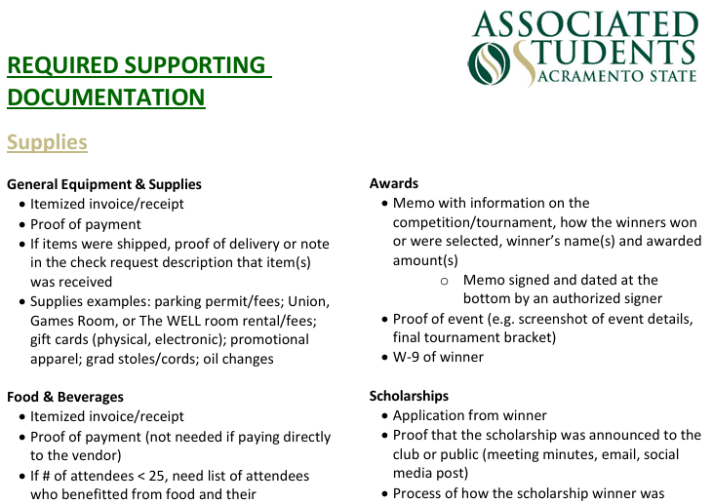
CHECK REQUESTS
  Please visit our website for a “cheat sheet” list of required supporting documentation to gather before completing the check request.

Slide 26
CHECK REQUESTS
  Important:
  The person filling out the check request cannot authorize (sign) a check request to pay/reimburse themselves.
  If you are paying/reimbursing the President, then the Treasurer (or like officer on the CAF) needs to fill out and sign (authorize) the check request.

Slide 27
CHECK REQUESTS
  Unallowable Expenditures:
  -personal items
  -alcohol
  -tobacco products
  -recreational drugs
  -weapons
  Note:
  All clubs can be audited and if found to have misused club or DOC funds can run the risk of suspension.

Slide 28
CHECK REQUEST EXAMPLE:
SUPPLIES
The Club’s Situation:
    Herkey T. Hornet and Me’we have renewed their club (Hornet & Squirrel) recognition with SO&L, and their Club Accounting Form (CAF) was approved.
    As they near the end of the semester, they have agreed to buy graduation regalia for a graduating club officer as an appreciation for her involvement in the past semester.
    Me’we requested their club account report and confirmed they have sufficient funds to make the purchase.
    Herky visited the ASI Student Shop to make the purchase and is seeking reimbursement.

Slide 29
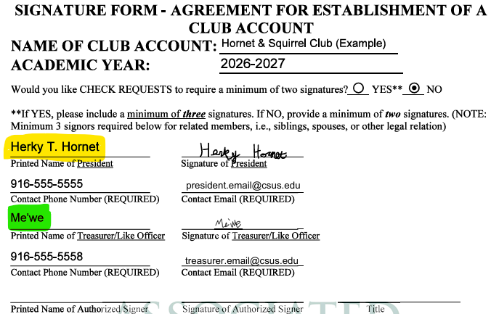
CHECK REQUEST EXAMPLE:
SUPPLIES
According to the approved Club Accounting Form (CAF), since Herky (president) purchased the graduation regalia, then Me’we will gather all the required information and supporting documentation to complete the check request.

Slide 30
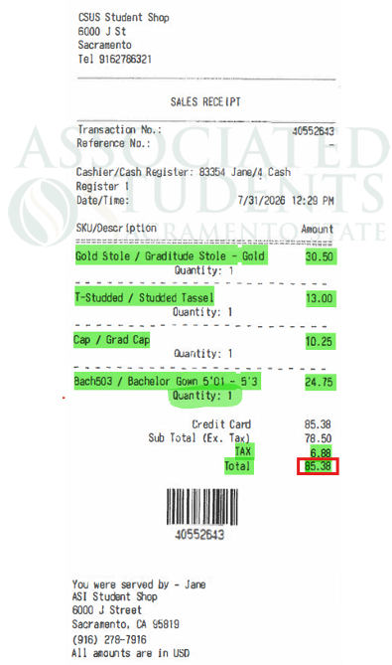
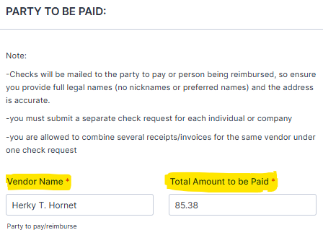
CHECK REQUEST EXAMPLE:
SUPPLIES
ASI Student Shop receipt:
Me’we will go to the Jotform link to complete the check request:
Enter the Vendor’s
(Herky) full legal name
Enter the total amount to pay the vendor
(nicknames and preferred
names are not acceptable)
Notes:
Enter the vendor’s (Herky) full legal name and the Total Amount to be Paid.
For this check request, since we are reimbursing for only one expenditure (ASI Student Shop regalia), we will enter the total from the receipt.
If there are multiple receipts, add the totals from the receipts, then enter the amount here.

Slide 31
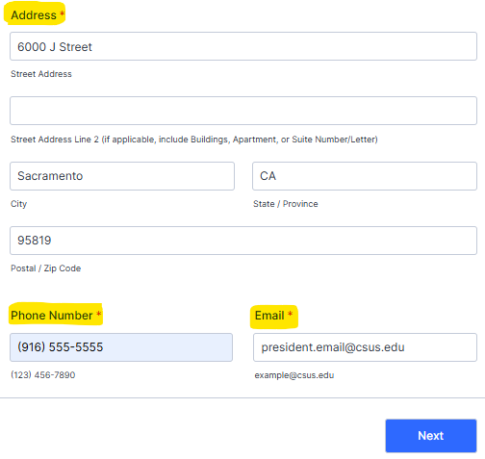
CHECK REQUEST EXAMPLE:
SUPPLIES
Enter the Vendor’s (Herky)
Mailing address
(include any building,
apartment, or
Suite number/letter)
Enter the Vendor’s (Herky)
Phone Number
Enter the Vendor’s (Herkey) Email Address
Notes:
Enter the vendor’s (Herky) mailing address, phone number, and email address.
Click “Next.”

Slide 32
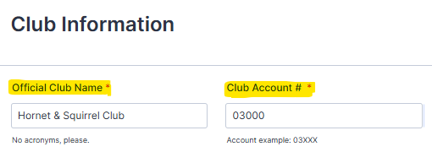
CHECK REQUEST EXAMPLE:
SUPPLIES
Enter the Club’s Official Name
Enter your Club Account Number
(no acronyms)
(found on the approved CAF emailed to you, or contact our office)
Notes:
Enter the official club name. No acronyms, please, as we manage 300+ accounts.
Enter the Club Account Number. This can be found on the approved CAF that was emailed to you, or you can contact our office for the number.

Slide 33
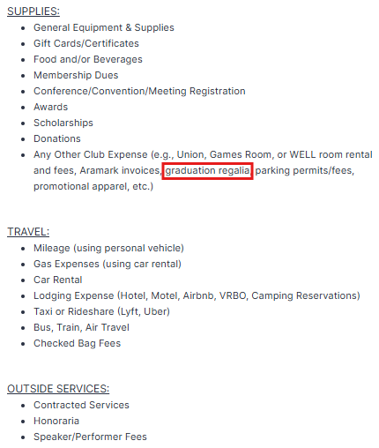
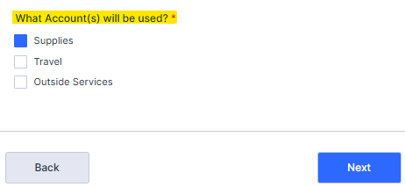
CHECK REQUEST EXAMPLE:
SUPPLIES
Based on the expenditure, select the Account type
Notes:
Based on the expenditure, select the “Account” type.
In this example, graduation regalia is not related to travel or an outside service, so we will select “Supplies.”

Slide 34
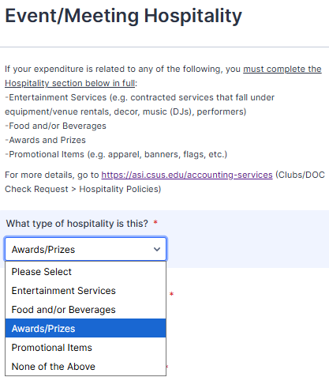
CHECK REQUEST EXAMPLE:
SUPPLIES
If the expenditure is an act of hospitality in these categories:
Entertainment Services
Food and/or Beverages
Awards and Prizes
Promotional Items
You will need to answer all questions in the Event/Meeting Hospitality section, otherwise, select “None of the Above.”

Slide 35
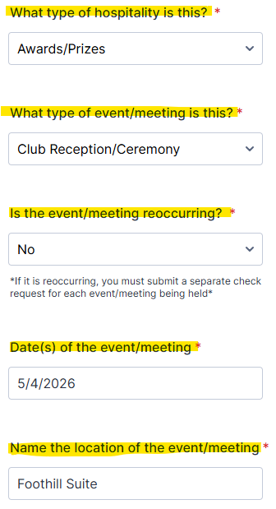
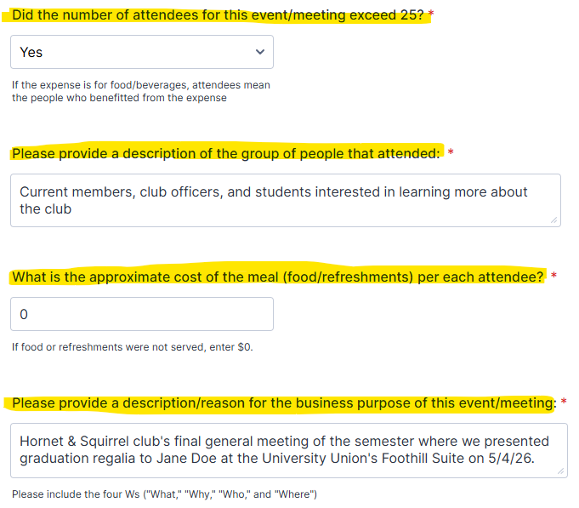
CHECK REQUEST EXAMPLE:
SUPPLIES
The Hospitality questions will include:

Slide 36
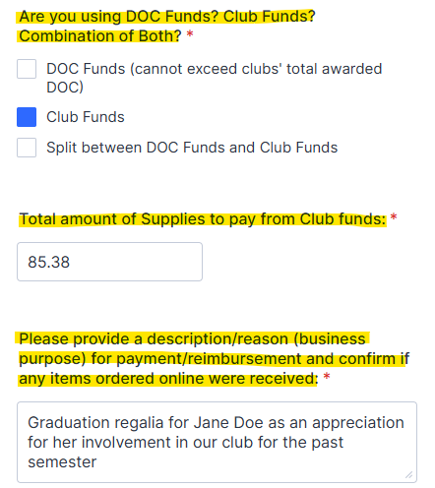
CHECK REQUEST EXAMPLE:
SUPPLIES
Supplies section:
Select either your Club Funds, DOC Funds, or a combination of both funds to pay this expenditure
Enter the amount to pay from the selected fund
Enter a brief description (club business purpose) for the payment/reimbursement
If you purchased items online, confirm the items were received/delivered.

Slide 37
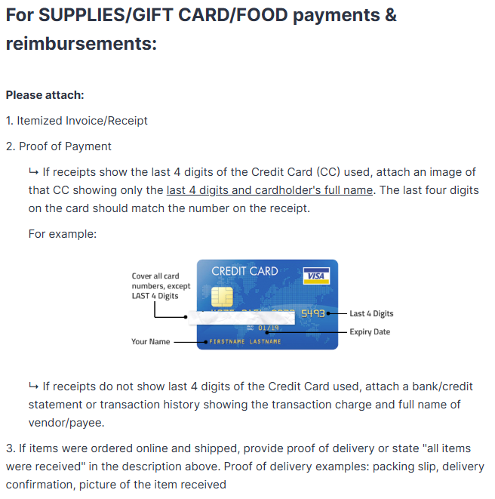
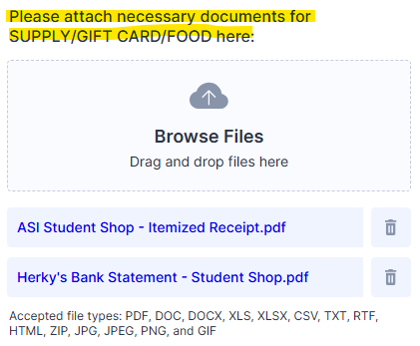
CHECK REQUEST EXAMPLE:
SUPPLIES
Supplies section:
Select or Drag and Drop the supporting documentation
Scroll down to the type of supply that best fits the expenditure.
It will list the required supporting documentation that you will attach.

Slide 38
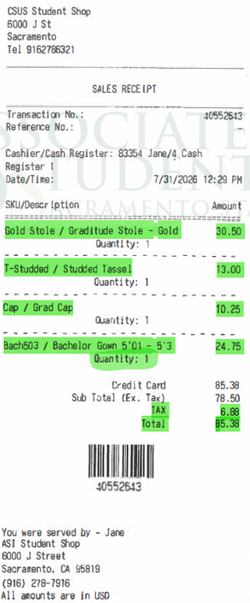
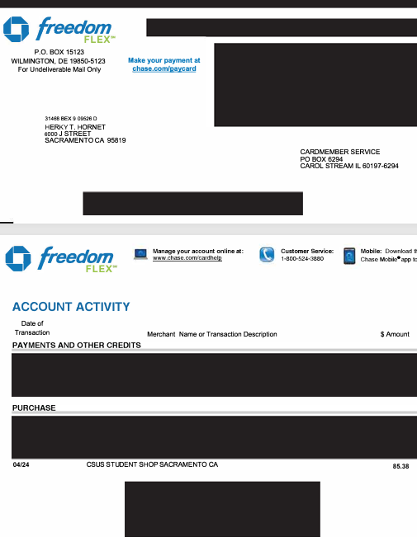
CHECK REQUEST EXAMPLE:
SUPPLIES
Itemized Receipt (ASI Student Shop)
Bank Statement

Slide 39
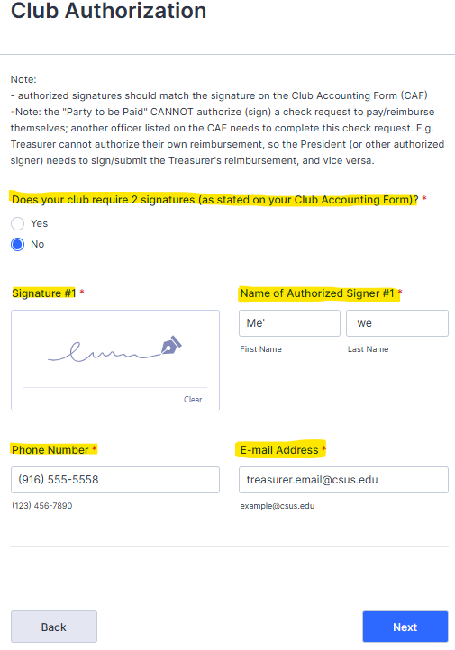
CHECK REQUEST EXAMPLE:
SUPPLIES
Me’we will enter their information under Club Authorization:
Refer to your CAF if your club requires two or more signatures
Add your signature
Enter your Full Name
(should match the signature on the CAF)
Enter your Phone Number
Enter your Email Address
Notes:
Why was Me’we the one to enter/sign the check request?

Slide 40
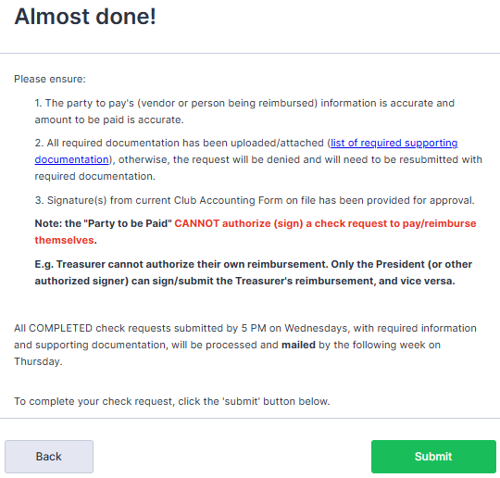
CHECK REQUEST EXAMPLE:
SUPPLIES
This is the final page before submitting the check request.
Please review to ensure:
Vendor’s information is accurate
All required documentation is uploaded/attached
Correct signature authorization was provided

Slide 41
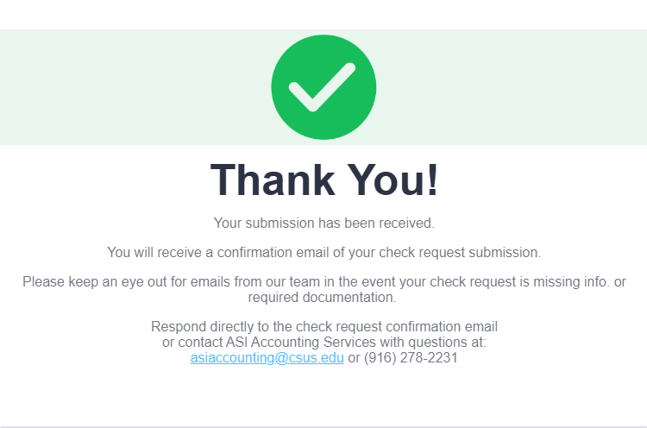
CHECK REQUEST EXAMPLE:
SUPPLIES
After you click “Submit,” you will receive a confirmation page

Slide 42
CHECK REQUEST EXAMPLE:
TRAVEL
The Club’s Situation:
    Herkey T. Hornet and Me’we have renewed their club (Hornet & Squirrel) recognition with SO&L, and their Club Accounting Form (CAF) was approved.
    Herky was invited to attend a leadership conference hosted at San Jose State University. Me’we requested their club account report. Since the club has limited funds due to upcoming expenses for other planned events, they have agreed they will reimburse his travel expenditure, but he will need to cover his own food during the trip.
    Herky used his own personal vehicle, returned from the Leadership Conference, and is seeking reimbursement.
Notes:
Who should submit the check request?

Slide 43
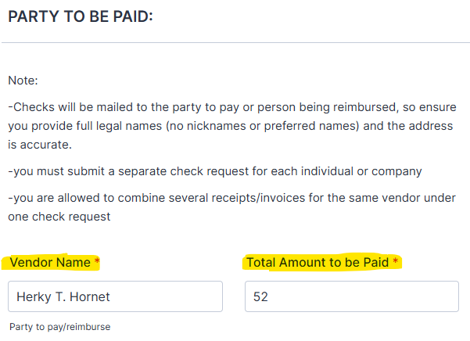
CHECK REQUEST EXAMPLE:
TRAVEL
Me’we will go to the Jotform link to complete the check request:
Enter the Vendor’s
(Herky) full legal name
Enter the total amount to pay the vendor
(nicknames and preferred
names are not acceptable)
Notes:
Enter the vendor’s (Herky) full legal name and the Total Amount to be Paid.
For this check request, since we are reimbursing for only one expenditure (mileage), we will enter the amount to reimburse. Per university’s business mileage rate, he is eligible to be reimbursed for $194.56, but the club decided to reimburse him based on the gas amount he actually spent to get to SJSU and back.
If there are multiple receipts, add the totals from the receipts, then enter the amount here.

Slide 44
CHECK REQUEST EXAMPLE:
TRAVEL
Enter the Vendor’s (Herky)
Mailing address
(include any building,
apartment, or
Suite number/letter)
Enter the Vendor’s (Herky)
Phone Number
Enter the Vendor’s (Herkey) Email Address
Notes:
Enter the vendor’s (Herky) mailing address, phone number, and email address.
Click “Next.”

Slide 45
CHECK REQUEST EXAMPLE:
TRAVEL
Enter the Club’s Official Name
Enter your Club Account Number
(no acronyms)
(found on the approved CAF emailed to you, or contact our office)
Notes:
Enter the official club name. No acronyms, please, as we manage 300+ accounts.
Enter the Club Account Number. This can be found on the approved CAF that was emailed to you, or you can contact our office for the number.

Slide 46
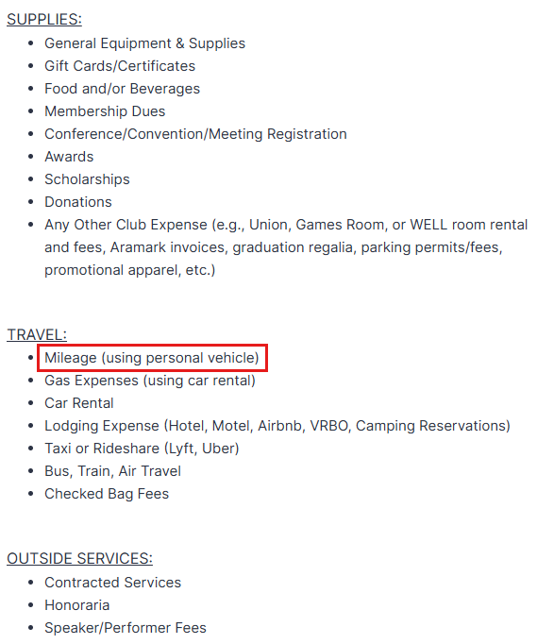
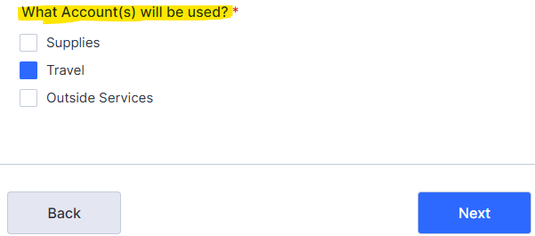
CHECK REQUEST EXAMPLE:
TRAVEL
Based on the expenditure, select the Account type
Notes:
Based on the expenditure, select the “Account” type.
In this example, since Herky used his personal vehicle, we will request a mileage reimbursement, so we will select “Travel.”

Slide 47
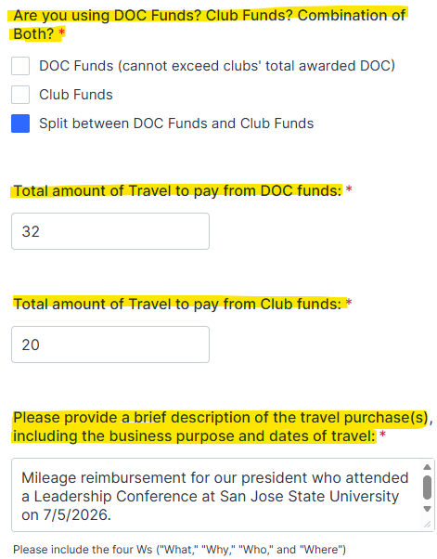
CHECK REQUEST EXAMPLE:
TRAVEL
Travel section:
Select either your Club Funds, DOC Funds, or a combination of both funds to pay this expenditure
Enter the amount to pay from the selected funds. If you add them up, they should equal the “Total Amount to be Paid”
Enter a brief description (club business purpose) for the payment/reimbursement

Slide 48
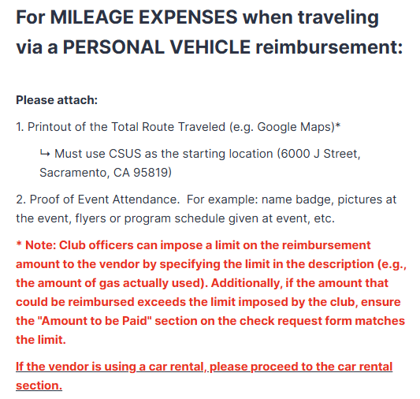
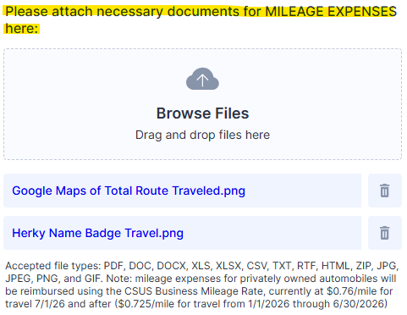
CHECK REQUEST EXAMPLE:
TRAVEL
Travel section:
Select or Drag and Drop the supporting documentation
Scroll down to the type of travel that best fits the expenditure.
It will list the required supporting documentation that you will attach.

Slide 49
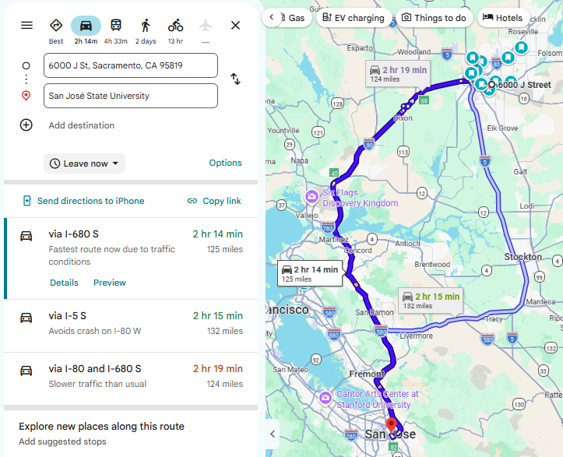

CHECK REQUEST EXAMPLE:
TRAVEL
Total Route Travelled
Proof of Event Attendance (name badge from conference)

Slide 50
CHECK REQUEST EXAMPLE:
TRAVEL
Me’we will enter their information under Club Authorization:
Refer to your CAF if your club requires two or more signatures
Enter your Full Name
Add your signature
(should match the signature on the CAF )
Enter your Phone Number
Enter your Email Address

Slide 51
CHECK REQUEST EXAMPLE:
TRAVEL
This is the final page before submitting the check request.
Please review to ensure:
Vendor’s information is accurate
All required documentation is uploaded/attached
Correct signature authorization was provided

Slide 52
CHECK REQUEST EXAMPLE:
TRAVEL
After you click “Submit,” you will receive a confirmation page

Slide 53
CHECK REQUEST EXAMPLE:
OUTSIDE SERVICES
The Club’s Situation:
    Herkey T. Hornet and Me’we have renewed their club (Hornet & Squirrel) recognition with SO&L, and their Club Accounting Form (CAF) was approved.
    The club hired Jane Smith (Sac State student) for bi-monthly dancing lessons. They agreed to pay $1,000 for the academic year, but will pay Jane with two $500 installments (Fall, Spring) after the services are rendered.
    Herky requested their club account report and confirmed they have sufficient funds. They just concluded their final dance practice and want to pay Jane the $500 Fall installment.

Slide 54
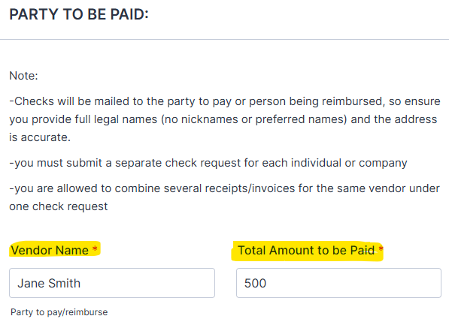
CHECK REQUEST EXAMPLE:
OUTSIDE SERVICES
Herky will go to the Jotform link to complete the check request:
Enter the Vendor’s
full legal name
Enter the total amount to pay the vendor
(nicknames and preferred
names are not acceptable)
Notes:
Enter the vendor’s full legal name and the Total Amount to be Paid.

Slide 55
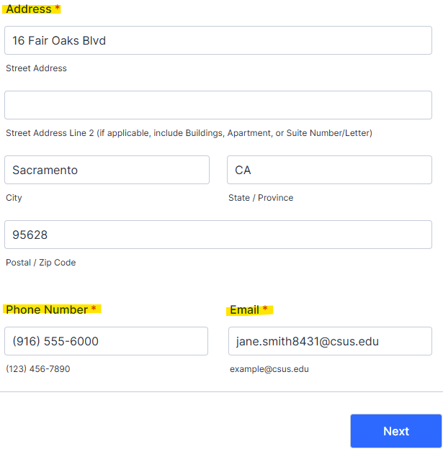
CHECK REQUEST EXAMPLE:
OUTSIDE SERVICES
Enter the Vendor’s
Mailing address
(include any building,
apartment, or
Suite number/letter)
Enter the Vendor’s
Phone Number
Enter the Vendor’s Email Address
Notes:
Enter the vendor’s mailing address, phone number, and email address.
Click “Next.”

Slide 56
CHECK REQUEST EXAMPLE:
OUTSIDE SERVICES
Enter the Club’s Official Name
Enter your Club Account Number
(no acronyms)
(found on the approved CAF emailed to you, or contact our office)
Notes:
Enter the official club name. No acronyms, please, as we manage 300+ accounts.
Enter the Club Account Number. This can be found on the approved CAF that was emailed to you, or you can contact our office for the number.

Slide 57
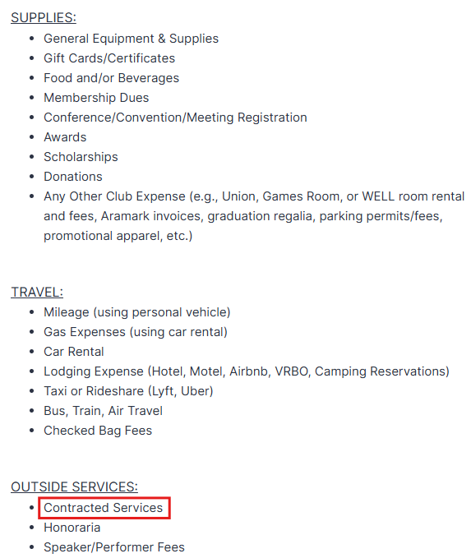
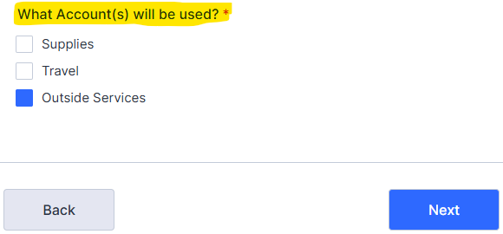
CHECK REQUEST EXAMPLE:
OUTSIDE SERVICES
Based on the expenditure, select the Account type
Notes:
Based on the expenditure, select the “Account” type.
In this example, because they hired someone for their services, we will select “Outside Services”

Slide 58
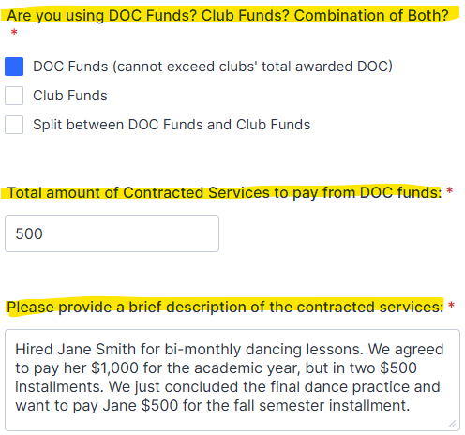
CHECK REQUEST EXAMPLE:
OUTSIDE SERVICES
Outside Services section:
Select either your Club Funds, DOC Funds, or a combination of both funds to pay this expenditure
Enter the amount to pay from the selected fund
Enter a brief description (club business purpose) of the contracted service

Slide 59
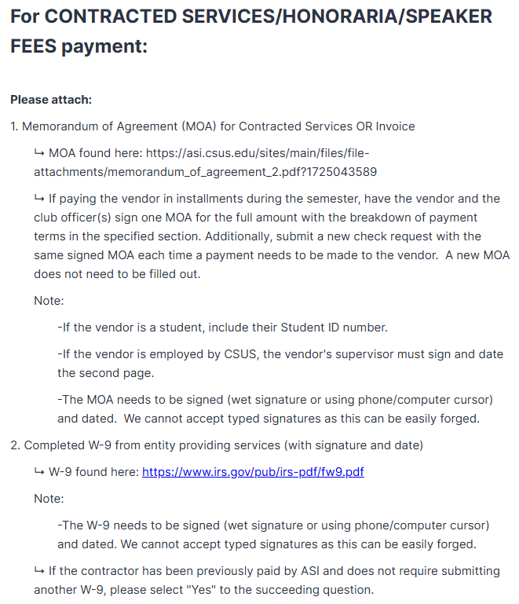
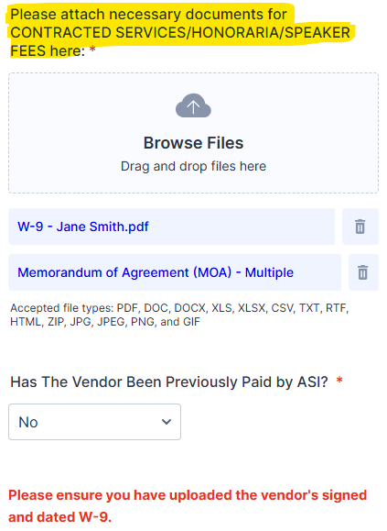
CHECK REQUEST EXAMPLE:
OUTSIDE SERVICES
Outside Services section:
Select or Drag and Drop the supporting documentation
Scroll down for the list of required supporting documentation that you will attach.
Notes:
For contracted services, attach the vendor-provided invoice OR a completed Memorandum of Agreement (MOA) if the service was performed on-campus.
You will also need to attach a completed W-9 by the vendor. This is required for reporting purposes.
Lastly, you will answer whether or not the vendor has been paid by ASI.
If the W-9 was previously submitted (for multiple payments to the same vendor), select “yes.” Our office will confirm whether or not we have the vendor’s W-9 on file and will reach out to the club, if needed.

Slide 60
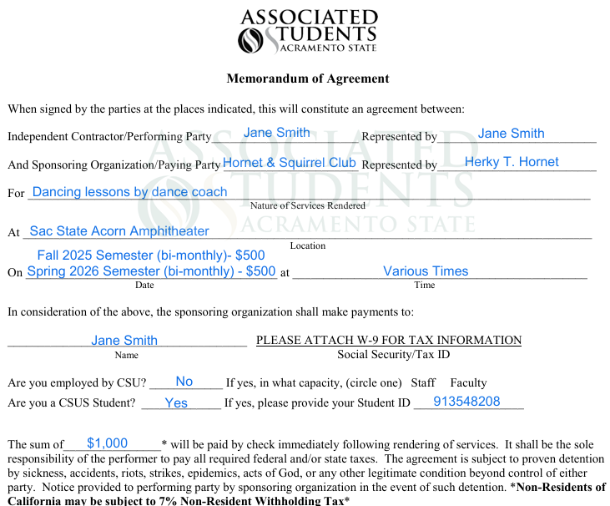
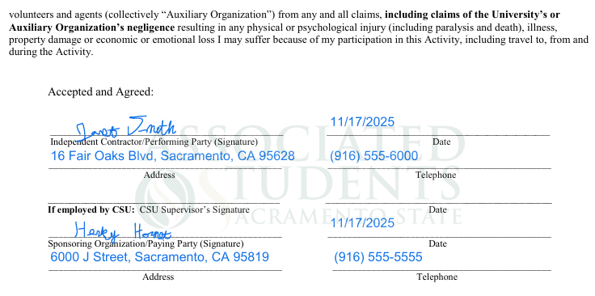
CHECK REQUEST EXAMPLE:
OUTSIDE SERVICES
Memorandum of Agreement (MOA) – Page 1
Memorandum of Agreement (MOA) – Page 2
Notes:
Here is an example of an MOA since the service was provided on-campus at the Acorn Amphitheater.
Since Jane is student, her student ID is required.
If the person providing the service is employed by CSU, please note this on the agreement and their supervisor needs to sign and date the second page (“If employed by CSU: CSU Supervisor's Signature)
The MOA must be signed with either a wet-signature or using your phone/computer’s cursor. We cannot accept typed signatures as this can be easily forged.

Slide 61
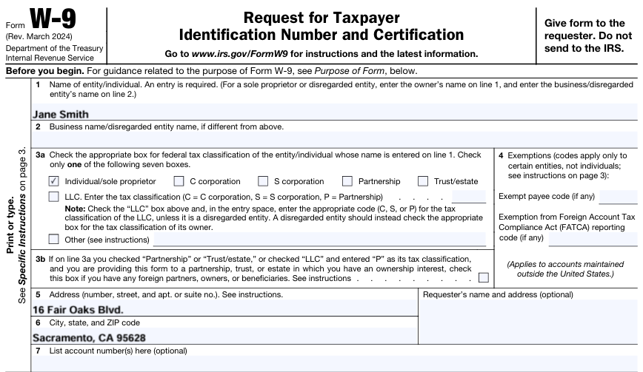
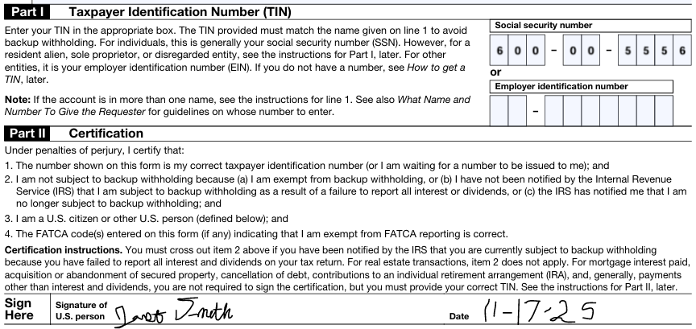
CHECK REQUEST EXAMPLE:
OUTSIDE SERVICES
W-9
W-9 (continued)
Notes:
Here is an example of a W-9.
If the W-9 is hand-written, please make sure it is legible.
Same with the MOA, the W-9 must be signed with either a wet-signature or using your phone/computer’s cursor. We cannot accept typed signatures as this can be easily forged.

Slide 62
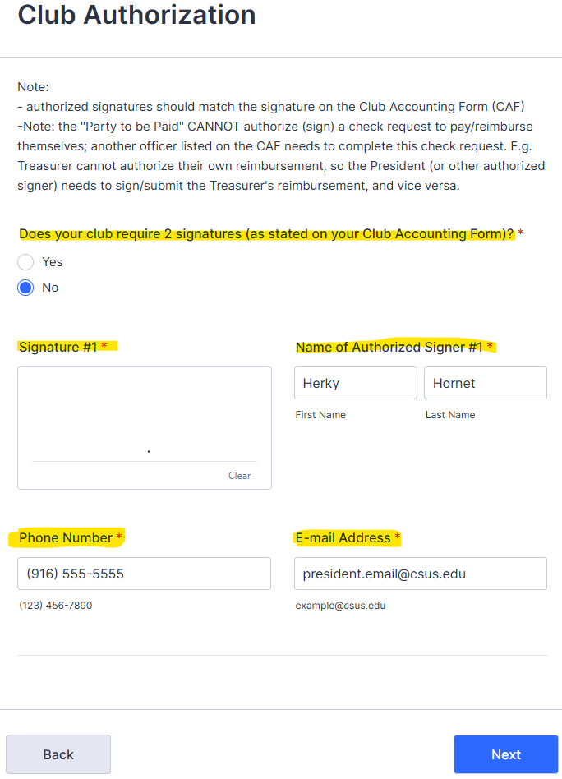
CHECK REQUEST EXAMPLE:
OUTSIDE SERVICES
Herky will enter their information under Club Authorization:
Refer to your CAF if your club requires two or more signatures
Add your signature
Enter your Full Name
(should match the signature on the CAF)
Enter your Phone Number
Enter your Email Address

Slide 63
CHECK REQUEST EXAMPLE:
OUTSIDE SERVICES
This is the final page before submitting the check request.
Please review to ensure:
Vendor’s information is accurate
All required documentation is uploaded/attached
Correct signature authorization was provided

Slide 64
CHECK REQUEST EXAMPLE:
OUTSIDE SERVICES
After you click “Submit,” you will receive a confirmation page

Slide 65
CHECK REQUEST EXAMPLE: AFTER SUBMISSION
The club officer who completed the form and the vendor will receive an email confirming that we have received your submission.
If you did not receive an email confirmation, then you did not completely submit the check request, or it is waiting for the second authorized signer to complete the Club Authorization section.
If there are any missing information or required supporting documentation, our team will reach out to you.
Our team will automatically deny the check request for a few reasons, including 4+ missing information/required supporting documentation and no active CAF for the academic year.
Notes:
The club officer who completed the form and the vendor will receive an email confirming that we have received your submission.
If you did not receive an email confirmation, then you did not completely submit the check request, or it is waiting for the second authorized signer to complete the Club Authorization section.
If there are any missing information or required supporting documentation, our team will reach out to you.
Our team will automatically deny the check request for a few reasons, including 4+ missing information/required supporting documentation and no active CAF for the academic year.

Slide 66
CHECK REQUEST:
ADVANCES
We offer check advances on a case-by-case basis.
Advance Check Requests require prior approval. All advance check inquiries with details of the expenditures must be made in-person at our office or via email (asiaccounting@csus.edu).
Advance checks follow the same processing time as a regular check request, so please submit a check request at least two weeks before the scheduled event.
Notes:
We offer check advances on a case-by-case basis.
Advance Check Requests require prior approval. All advance check inquiries with details of the expenditures must be made in-person at our office or via email (asiaccounting@csus.edu).
Advance checks follow the same processing time as a regular check request, so please submit a check request at least two weeks before the scheduled event.

Slide 67
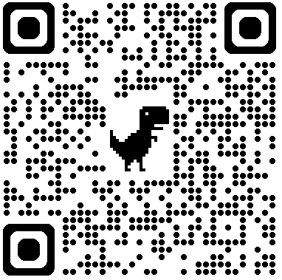
NEED CLUB BANKING HELP?
Please explore our website!
There are many resources available to you, including videos, links to the CAF and Jotform Check Request, information on DOC grant, list of required supporting documentation for check requests, and a Frequently Asked Questions (FAQ) section.
Website: www.asi.csus.edu/accounting-services
Ask us!
Phone: (916) 278-2231
Email: asiaccounting@csus.edu
Office: University Union; 3rd floor, Room 3230
Notes:
Please visit and explore our website!
There are many resources available to you, including videos, links to the CAF and Jotform Check Request, information on DOC grant, list of required supporting documentation for check requests, and a Frequently Asked Questions (FAQ) section.
After reviewing our website, if you have any questions, you can contact us via phone, email, and in-person at our office on the 3rd floor of the Union, next to the ASI Student Shop window.

Slide 68
QUESTIONS?
Notes:
At this time, we will answer any questions you may have.

