Slide 1




ASI
Accounting Services
CLUB CHECK REQUEST

Slide 2


01
Check Request Must Haves
TABLE OF
CONTENTS
02
Types of Check Requests
03
Things To Note
04
Thee Holy CR Grail
05
DOC Funding Guidelines
06
Advance Check Request
07
Contact Us

Slide 3


01
Check Request Must Haves
CHECK REQUEST MUST HAVES
RECEIPTS, RECEIPTS, RECEIPTS
No reimbursements for Personal Items, Drugs, Guns, or Alcohol
Ensure receipt is itemized with card number visible*
Full name is visible on card or bank statement*
SIGNER MUST BE ON CAF FORM
Signer cannot also be the vendor
Got Club/DOC Funding?
*Last 4 digits of card must match receipt*
*full name on bank statement must match Vendor*

Slide 4

02
TYPES OF CHECK REQUESTS
Supplies
Outside Services
Travel

Slide 5




TYPES OF CHECK REQUESTS
TRAVEL
SUPPLIES
  Mileage/Gas Expenses
  Car Rental
  Hotel Expenses
  Rideshare (Lyft, Uber, Taxi)
  Bus, Train, Air Travel
  General Equipment & Supplies
  Gift Cards/Certificates
  Food and/or Beverages
  Membership Dues
  Conference/Convention/Meeting Registration
  Awards or Scholarships
  Donations
  Any Other Club Expense
OUTSIDE SERVICES
  Contracted Services
  Honoraria
  Speaker/Performer Fees

Slide 6

03
THINGS TO NOTE
WEBSITE & RESOURCES
ASI Website - ASI Accounting Services
Check Request Form - Jotform Club Check Request
Check Request Documentation Requirements – Requirements
Website FAQs - JotForm/Check Request How To & FAQs

Slide 7


THINGS TO NOTE
OVERVIEW
REMINDERS
Outside service cannot be paid out of pocket.
Requests made by 5 p.m. on Wednesdays will be included in that week’s check batch to be mailed the following Thursday.
Checks are mailed. Indicate on check request if vendor prefers to pick it up at the ASI Student Shop window
There will be a delay in processing if the request is incomplete.
Resubmissions or edits to requests will not adhere to original submission deadlines.
Resources
Notes:
-

Slide 8
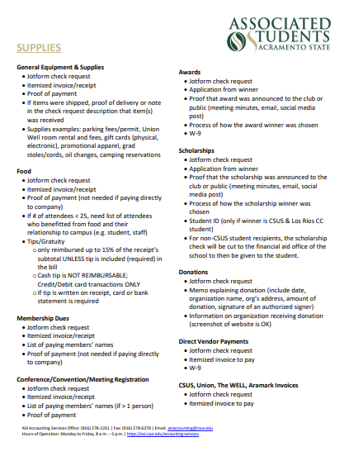

04
THEE HOLY CR GRAIL
  Depending on the type of check request you're submitting, there are specific documents you’ll need to include — such as itemized receipts, proof of payment, or agreements.
  To avoid delays, make sure to attach all required documentation to your submission.
  For a complete list of required documents by request type, please refer to the Check Request Documentation Cheat Sheet (PDF) linked on the right.
Click for PDF
Notes:
Cheat Sheet updated 9/2/25

Slide 9
05
DOC FUNDING GUIDELINES
  Dollars for Organizations and Clubs (DOC) Funds
  The purpose of ASI Dollars for Organizations and Clubs (DOC) funding is to support Sac State students in their endeavors to increase the quality of campus life and learning. ASI DOC funding reimburses organizations and clubs for money spent on events, food, promotion, conferences and much more.
  Please refer to the DOC Funding Guidelines to learn more on how you can use your DOC Funds!
Click for PDF

Slide 10

06
ADVANCE CHECK REQUEST
Advance Check Requests are reviewed on a case-by-case basis and require prior approval.
All inquiries must be made in-person at our office or via email at asiaccounting@csus.edu

Slide 11


07
CONTACT US
Questions?
You can reach us via phone, email, or in-person.
Visit us in-person at our office in the University Union (3rd Floor, Room 3230)
We are available Monday through Friday from 8 a.m. to 5 p.m. during the semester. Please check our website for hours during breaks and office closures.
For more information, please visit our website at https://asi.csus.edu/accounting-services
(916) 278-2231
asiaccounting@csus.edu

